Slide 1
Using Cycle Efficiency as a System Designer Metric to Characterize an Embedded DSP and Compare Hard Core vs. Soft Core
Master’s Project Defense
Rathan Raj
Advisor
Dr. Vishwani D. Agrawal
Committee Members
Dr. Victor P. Nelson, Dr. Adit D. Singh
October 1, 2013

Slide 2
Outline
Motivation
Background
Problem Statement
Implementation
Results
Conclusion
Limitations and Future Work
References

Slide 3
Motivation
Performance
Power
Area
Performance, Power and Area are three conflicting goals, and industry demands that all three aspects be co-optimized.
To obtain a complete performance modeling requires marrying everything from high-level modeling and synthesis to better characterization and verification.

Slide 4
Background
What is Characterization?
Characterization over Process, Voltage, Temperature
Performance Metric
Energy Efficiency Metric

Slide 5
Background
Performance Metrics:
Clock Frequency
MIPS
MFLOPS
SPEC ratio
Relative Efficiency
SWAP
Performance per Watt
Cycle Efficiency
Source: D. A. Patterson and J. L. Hennessy, Computer Organization & Design: The Hardware/Software Interface, 4th Edition, Morgan Kaufmann Publishers (Elsevier), 2009
A. Shinde and V. D. Agrawal, “Managing Performance and Efficiency of a Processor,” Proc. 45th IEEE Southeastern Symp. System Theory, March 2013

Slide 6
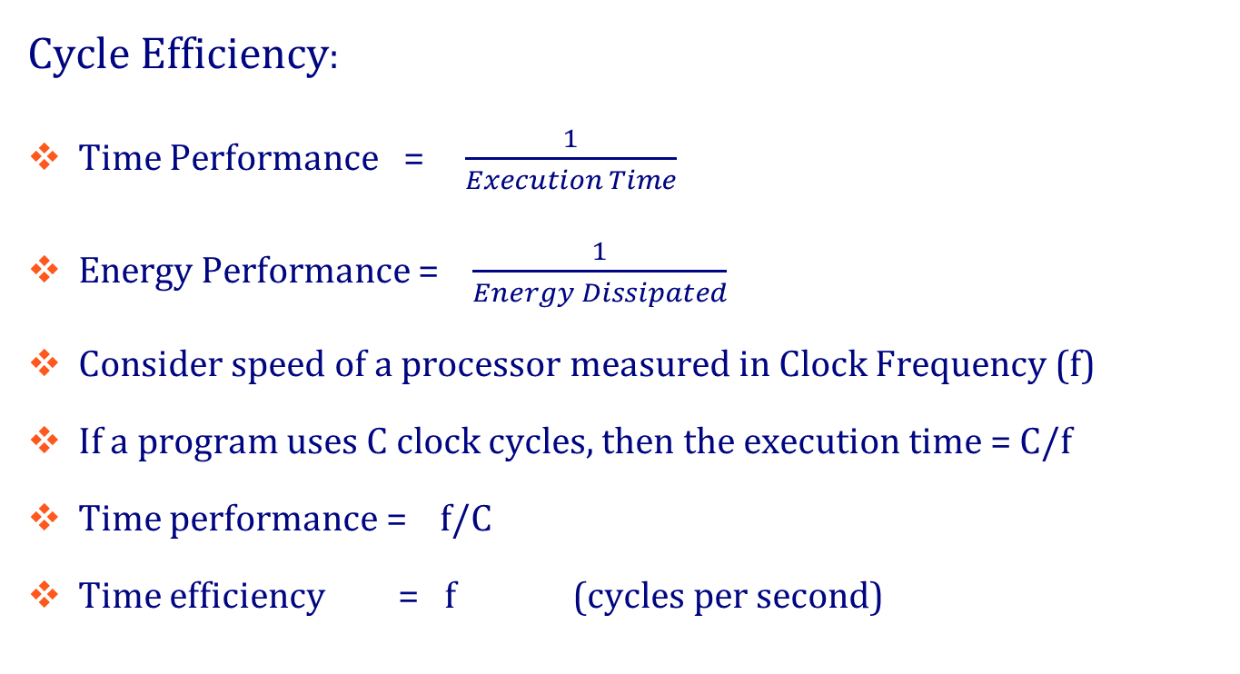
Background
Cycle Efficiency:
Time Performance = $\frac{1}{Execution Time}$
Energy Performance = $\frac{1}{Energy Dissipated}$
Consider speed of a processor measured in Clock Frequency (f)
If a program uses C clock cycles, then the execution time = C/f
Time performance = f/C
Time efficiency = f (cycles per second)

Slide 7
Background
The energy efficiency of a processor can be measured in terms of cycles/Joule.
Cycle Efficiency (η) = $\frac{1}{EPC}$ cycles/J
Consider a program which takes C clock cycles, Energy Dissipated = $\frac{C}{η}$
Energy Performance = $\frac{η}{ C}$
Cycle Efficiency is an energy efficiency metric.
It can be compared to performance in speed metric ‘f’.
f → mph η → mpg
Source: A. Shinde and V. D. Agrawal, “Managing Performance and Efficiency of a Processor,” Proc. 45th IEEE Southeastern Symp. System Theory, March 2013
Dr. Agrawal, Lower Power Design of Electronic Circuits, lecture_8.ppt

Slide 8
Problem Statement
Can we characterize an embedded DSP in an FPGA and use cycle efficiency to analyze its performance? Also, use cycle efficiency to compare the performance of a Hard Core to a Soft Core.

Slide 9
Implementation
Lattice ECP3 65nm FPGA
Design & Synthesis Tool –Lattice Diamond
Lattice ECP3 DSP unit has cascadable DSP slices that are ideal for power sensitive wireless applications and image signal processing.
Implementation of the function: Multiply Accumulate (MAC) An x Bn + Pn-1 = Pn
Source : Lattice ECP3 SysDSP usage guide

Slide 10
Design Flow
Design Flow
Design Entry
Synthesis
Functional Simulation
No
Design Correct?
Yes
Fitting
Timing Analysis and Simulation
No
Timing requirements met?
Yes
Characterization & Programming
October 1, 2013
10

Slide 11
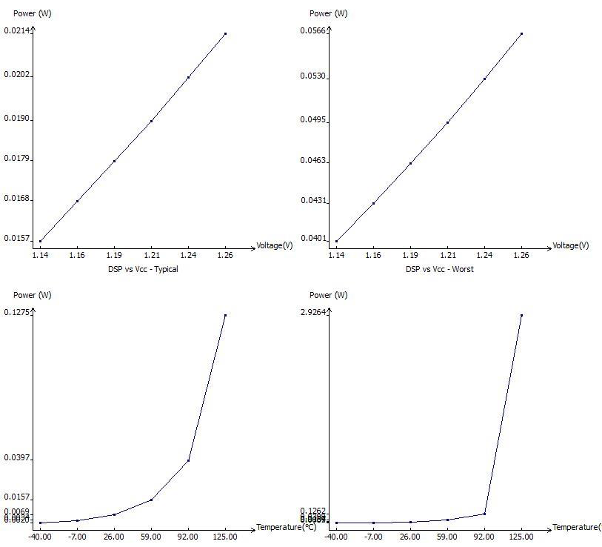
Power Analysis
Power Analysis: 65nm Hard DSP at V_{dd}=1.2V, f=280 MHz, No. of execution cycles= 1.5 x10⁶cycles
Typical
Worst

Slide 12
Results
Power Dissipation and Cycle efficiency Calculations
Temperature(⁰C) | P_{Static} (mW) | P_{Dyn} (mW) | P_{T}(mW) | E_{Total} (µJ) | EPC (nJ/cycle) | Cycle Efficiency (η) 10⁹cycles/J
0 | 7.4 | 1.0 | 8.4 | 45.3 | 0.03 | 33
25 | 10.2 | 1.0 | 11.2 | 60 | 0.04 | 25
45 | 14.1 | 1.0 | 15.1 | 82.5 | 0.054 | 18
65 | 17.2 | 1.0 | 18.2 | 98 | 0.065 | 13
85 | 34 | 1.0 | 35 | 187 | 0.125 | 8
100 | 53.3 | 1.0 | 54.3 | 292 | 0.194 | 5
Worst Process, V_{dd} = 1.2 V, Fmax = 280 MHz, No. of execution cycles = 1.5 x 10⁶ cycles.

Slide 13
Cycle Efficiency(η) vs. T
V = 1.2V, Fmax = 280 MHz, No. of Execution cycles = 1.5 x 10⁶ cycles.

Slide 14
Results
Performance grade(Process Variation) at different Temperatures and Cycle efficiency
Performance grade T=0⁰C | Fmax | Etotal (µJ) | EPC (nJ) | η (10⁹ cycles/J)
6 (worst) | 281.6 | 46.5 | 0.031 | 32
7 (typical) | 305.3 | 45.0 | 0.030 | 33
8 (best) | 341.4 | 43.5 | 0.029 | 36
Performance grade T=25⁰C | Fmax | Etotal (µJ) | EPC (nJ) | η (10⁹ cycles/J)
6 (worst) | 281.6 | 63.0 | 0.042 | 23
7 (typical) | 305.3 | 58.5 | 0.039 | 24
8 (best) | 341.4 | 57.0 | 0.038 | 26
Performance grade T=50⁰C | Fmax | Etotal (µJ) | EPC (nJ) | η (10⁹ cycles/J)
6 (worst) | 281.6 | 93.0 | 0.062 | 16
7 (typical) | 305.3 | 87.0 | 0.058 | 17
8 (best) | 341.4 | 82.0 | 0.055 | 20
Performance grade T= 100⁰C | Fmax | Etotal (µJ) | EPC (nJ) | η (10⁹ cycles/J)
6 (worst) | 281.6 | 300.0 | 0.020 | 5
7 (typical) | 305.3 | 276.0 | 0.184 | 5
8 (best) | 341.4 | 255.0 | 0.170 | 6

Slide 15
Performance Grade and η
Effect of process variation at different Temperatures on Cycle Efficiency
V_{dd} = 1.2V, No. of execution cycles = 1.5 x 10⁶

Slide 16
Comparison of Hard DSP vs. Soft Core (LUT-based)
Device: 90 nm Stratix II GX FPGA
CAD Tool for Design & Synthesis – Quartus 2
MAC operation on both implementations.
Implementation using only the Embedded DSP unit
4 DSP 9x9 multipliers
Implementation using only Logic Elements
337 LUT + 97 Registers

Slide 17
Results
Comparison of Hard DSP vs. Soft DSP(LUT)
Resource Utilization | F_{max}(MHz) | P_{Static}(mW) | P_{Dyn} (mW) | P_{I/O}(mW) | P_{Total} (mW) | E_{Total}(µJ) | EPC (nJ/cycle) | Cycle Efficiency (η) mega cycles/J
4 DSP 9x9 multipliers (Hard Core) | 450.05 | 491.05 | 78.8 | 301.81 | 871.66 | 3000 | 2.0 | 500
338 LUT + 97 registers (Soft Core) | 188.7 | 498.85 | 140.07 | 298.01 | 930.02 | 7350 | 4.9 | 204
V_{dd} = 1.2 V, No. of Execution Cycles = 1.5x10⁶, and T = 25⁰C

Slide 18
Summary
As Temperature increases, cycle efficiency decreases.
From 45⁰C - 100⁰C, there is a 40 % decrease in the cycle efficiency.
The Cycle efficiency calculations at different Performance grades were calculated over the operating temperature range.
Hard DSP vs. Soft DSP (LUT): The dynamic power consumed by the Hard Core was 55 % higher than the dynamic power consumed by the Soft Core. The cycle efficiency of the Hard Core implementation was 150% more than the Soft Core.

Slide 19
Conclusion
For system designers who are required to design systems which work robustly under extreme temperature conditions, the cycle efficiency calculations provide valuable insight into the power and performance for the design.
Characterization and Performance analysis over Process, Temperature and Voltage allows the designer to effectively optimize the time and energy requirements of an electronic system.

Slide 20
Limitations and Future Work
Characterization was accurate in terms of the design and implementation. However, the Lattice ECP3 device was assumed to be running at a fixed V_{dd}
Tool limitations do not allow frequency and voltage calculations over varying temperature
A Characterization of voltage with varying temperatures and scaling of voltage into the sub-threshold regions will help in better voltage characterization.

Slide 21
Limitations and Future Work
Cycle efficiency can be used in the industry as a performance metric that not only can be applied in the characterization phase but also in the architectural phase for making better engineering judgments during choices of systems and components

Slide 22
References
Agrawal, V. D., “Low Power Design of Electronic Circuits,” Power Aware Microprocessors, ELEC-6270, Spring 2013
Altera Corporation, “DSP Blocks in Stratix II and Stratix II GX Devices,” January 2008.
Altera Corporation, “Stratix II Architecture,” May 2007.
Lattice Semiconductor- Diamond Student Web edition.
Lattice Semiconductor, “Lattice ECP3 SysDSP Usage Guide, Technical note TN8112,” February 2012.
Lattice Semiconductor, “Lattice Power Consumption and Management for LatticeECP3 Devices Usage Guide, Technical note TN1181,” February 2012.
Mirzaei, Shahnam, “Design Methodologies and Architectures for Digital Signal Processing on FPGAs,” in Doctor of Philosophy’s dissertation, University Of California Santa Barbara, June 2010.
Patterson, D. A., Hennessy, J. L., Computer Organization & Design: The Hardware/Software Interface, 4th Edition, Morgan Kaufmann Publishers (Elsevier), 2009
Shinde, A., Agrawal, V. D., “Managing Performance and Efficiency of a Processor,” Proc. 45th IEEE Southeastern Symp. System Theory, March 2013

Slide 23
Thank You

Slide 24
Questions?

